Slide 1

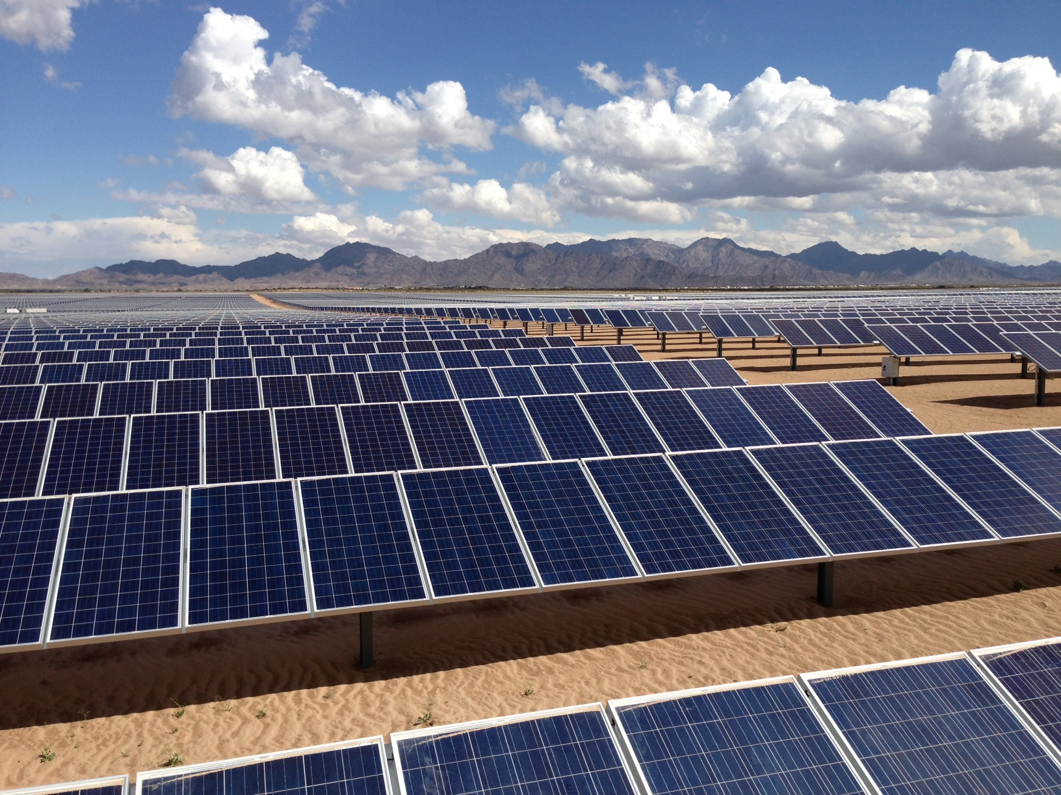
PV Solar Projects

Slide 2
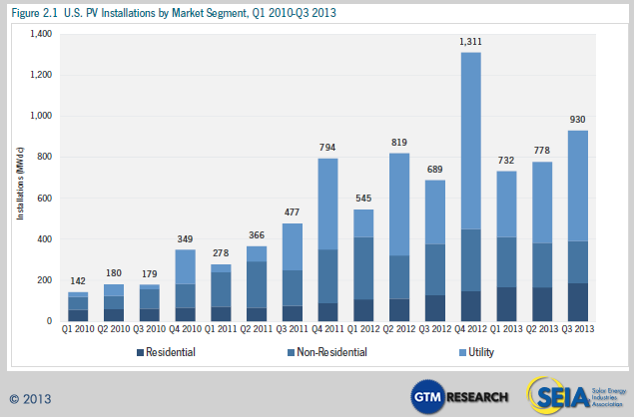
PV Solar Installations 2010-2013

Slide 3
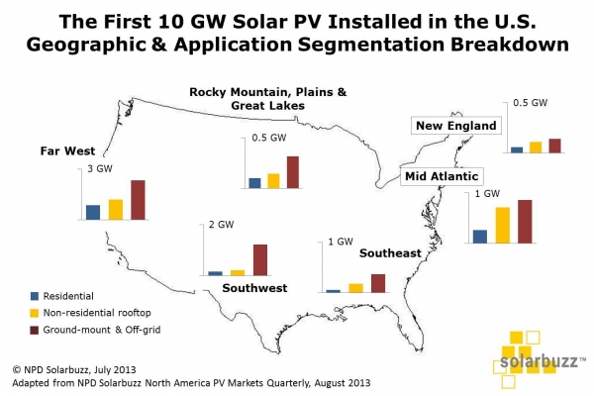
PV Solar Exceeds 10 GW in 2013
The 2012 total US electric generation capacity was 1,063 GW.
The main energy sources include:
Thermal/Fossil 776 GW
Nuclear 102 GW
Hydropower 79 GW
Wind 59 GW

Slide 4
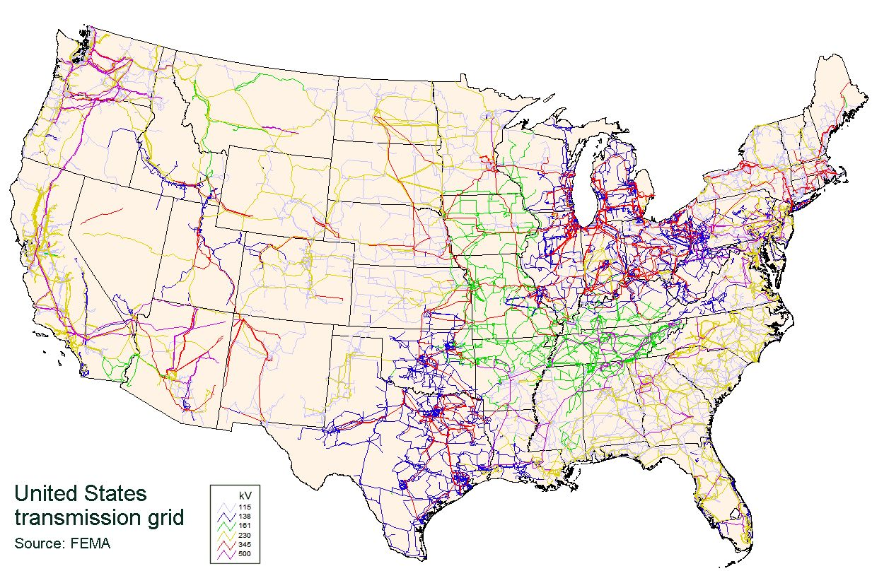
United States Electric Grid; the largest interconnected
machine on earth

Slide 5
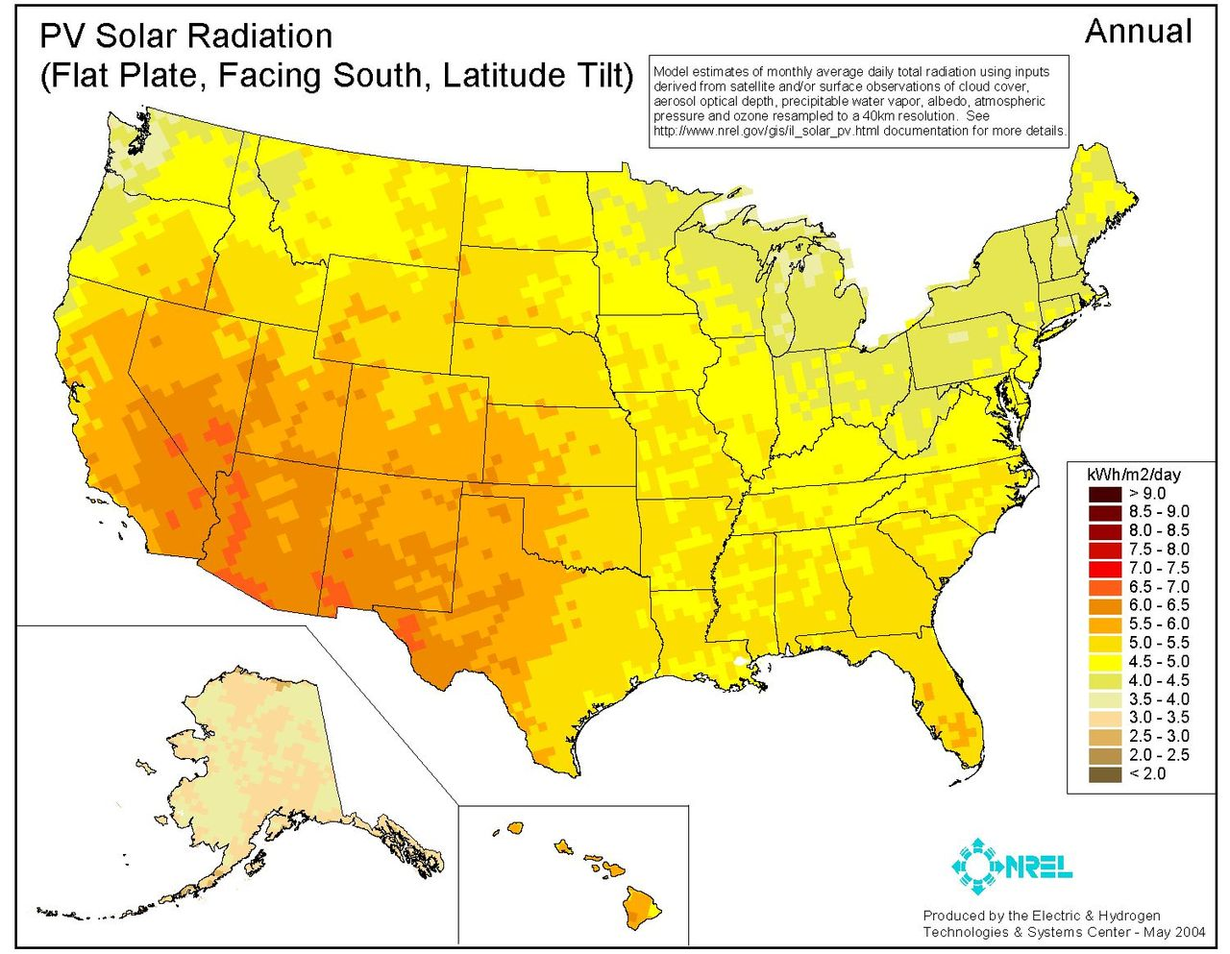
Location, Location
PV Solar Project Locations

Slide 6
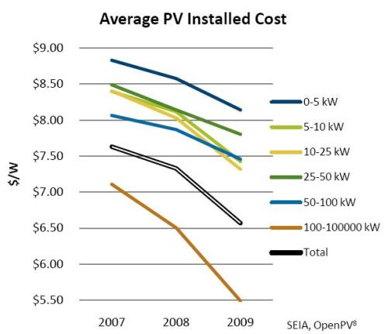
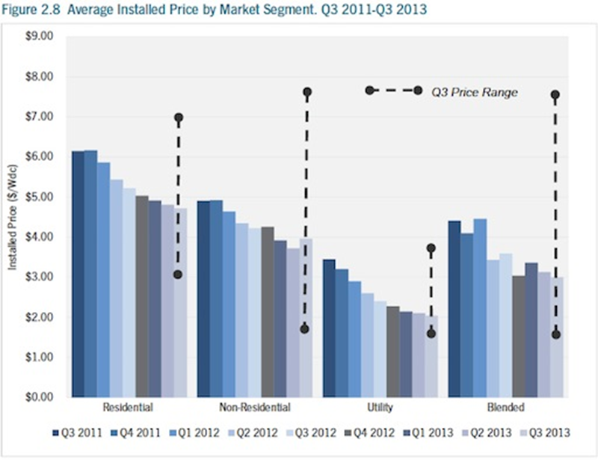
PV Solar Installed Cost Dropping

Slide 7
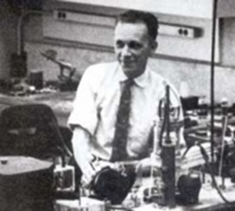
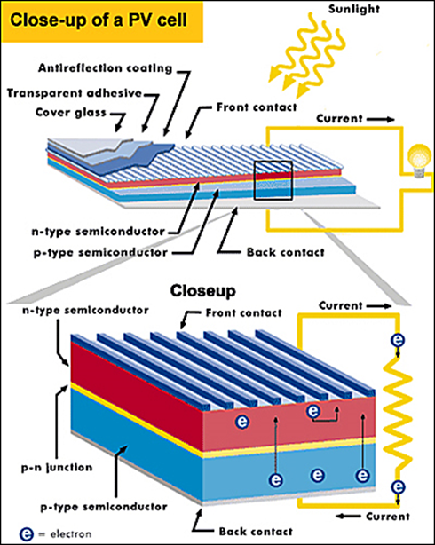
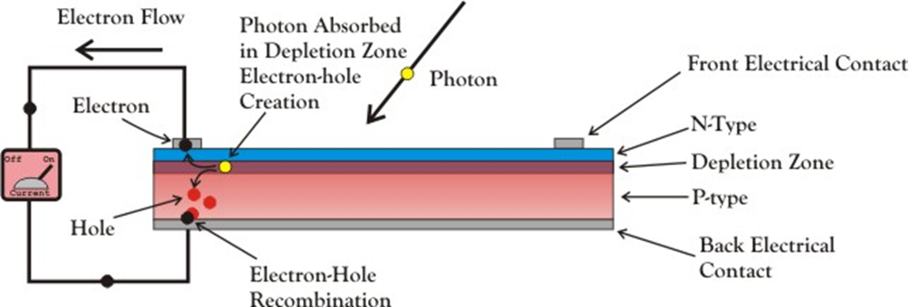
PV Photo-Voltaic Cell
Russell Ohl 1940

Slide 8
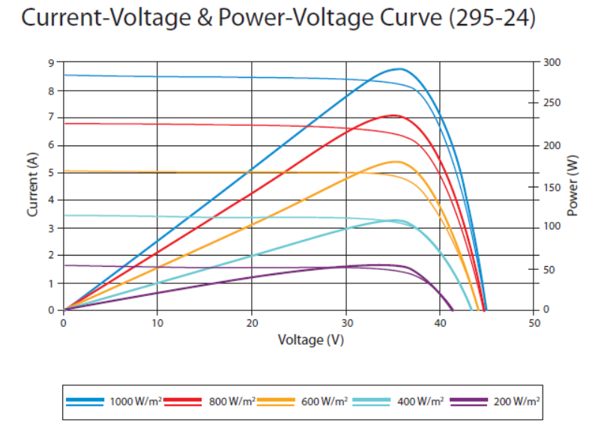
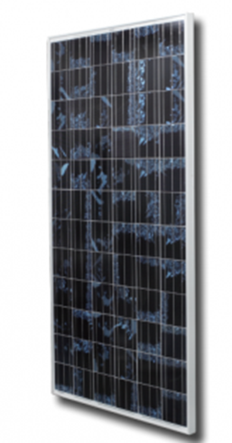
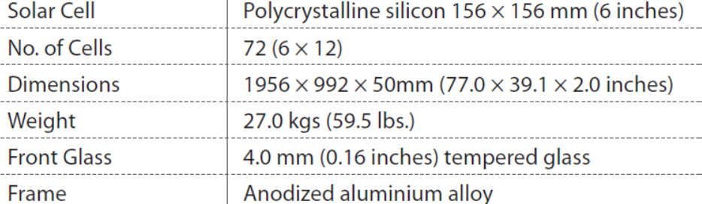
PV Solar
Review
Modules

Slide 9
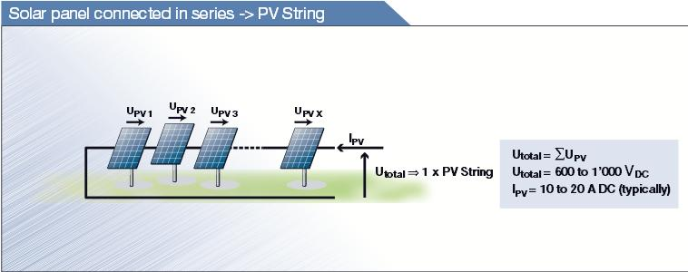
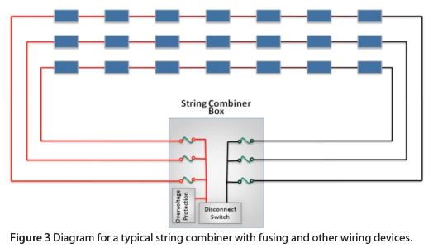
PV module string

Slide 10
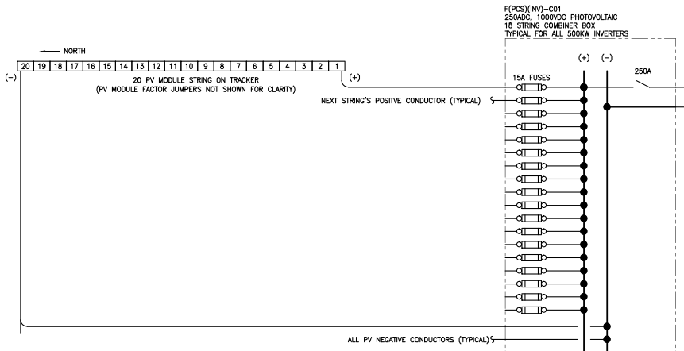
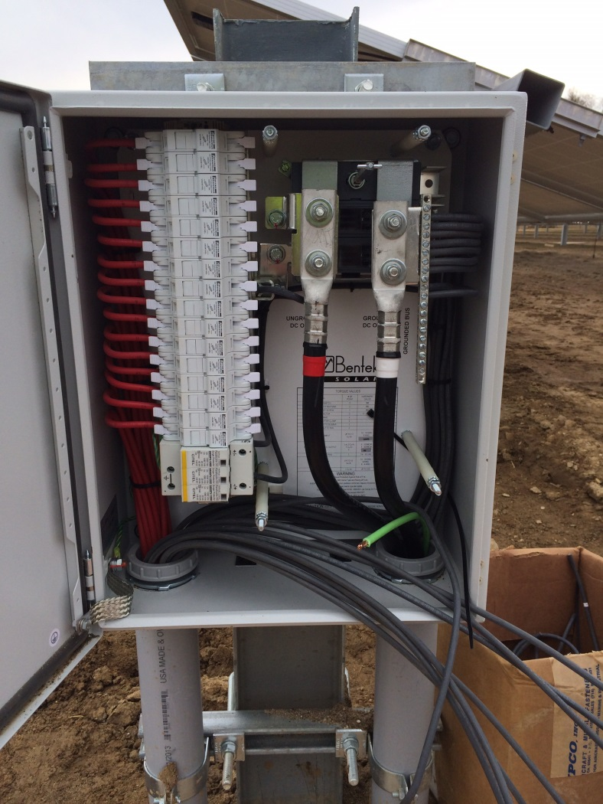
PV string combiner box

Slide 11
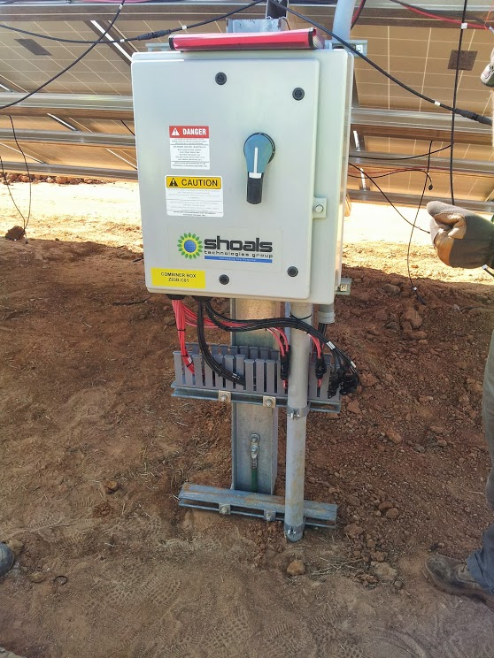
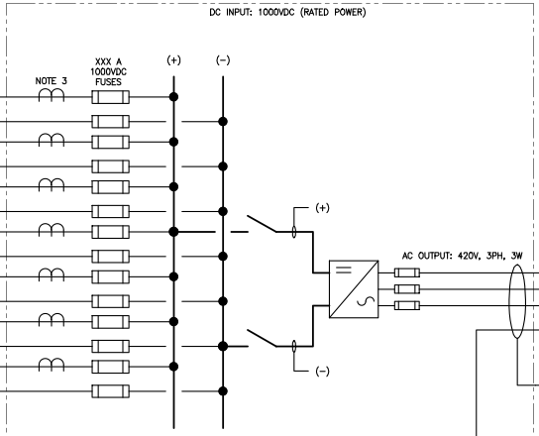
Combiner Box

Slide 12
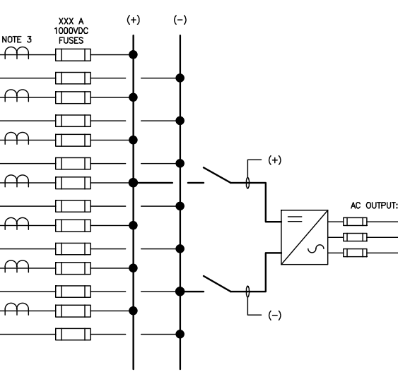
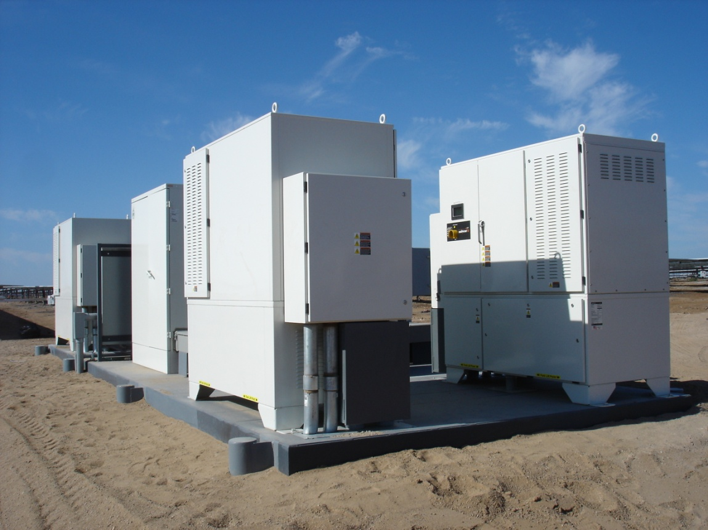
Inverters

Slide 13
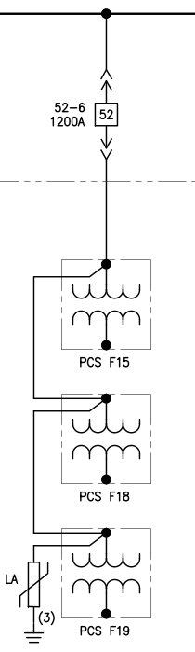
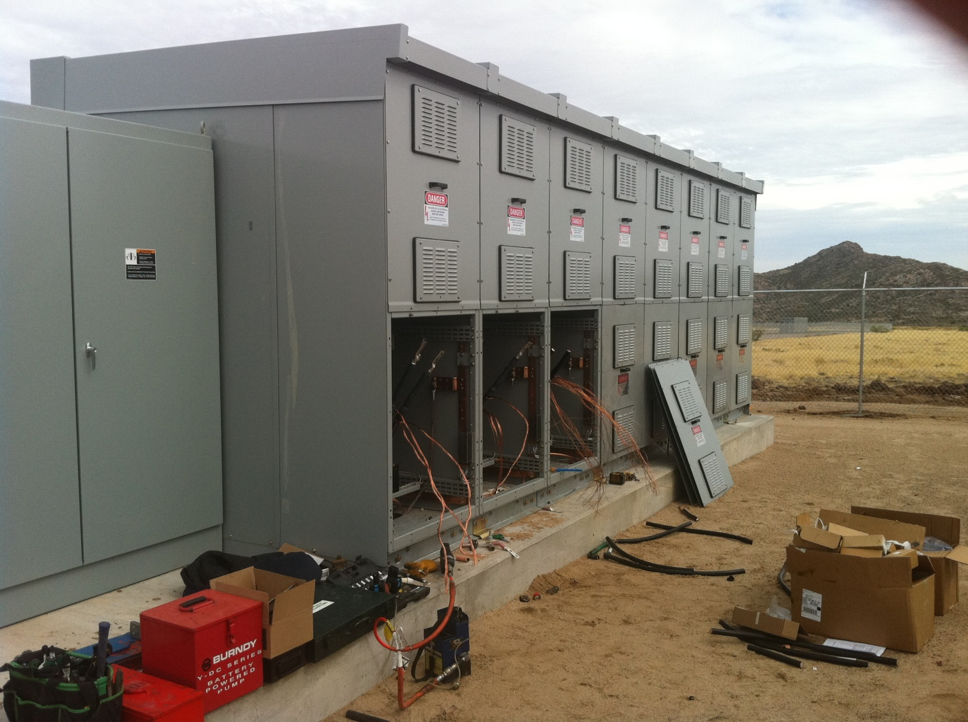
Collector system

Slide 14
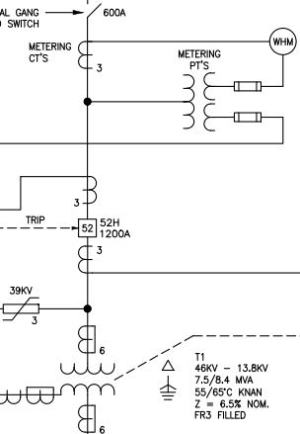
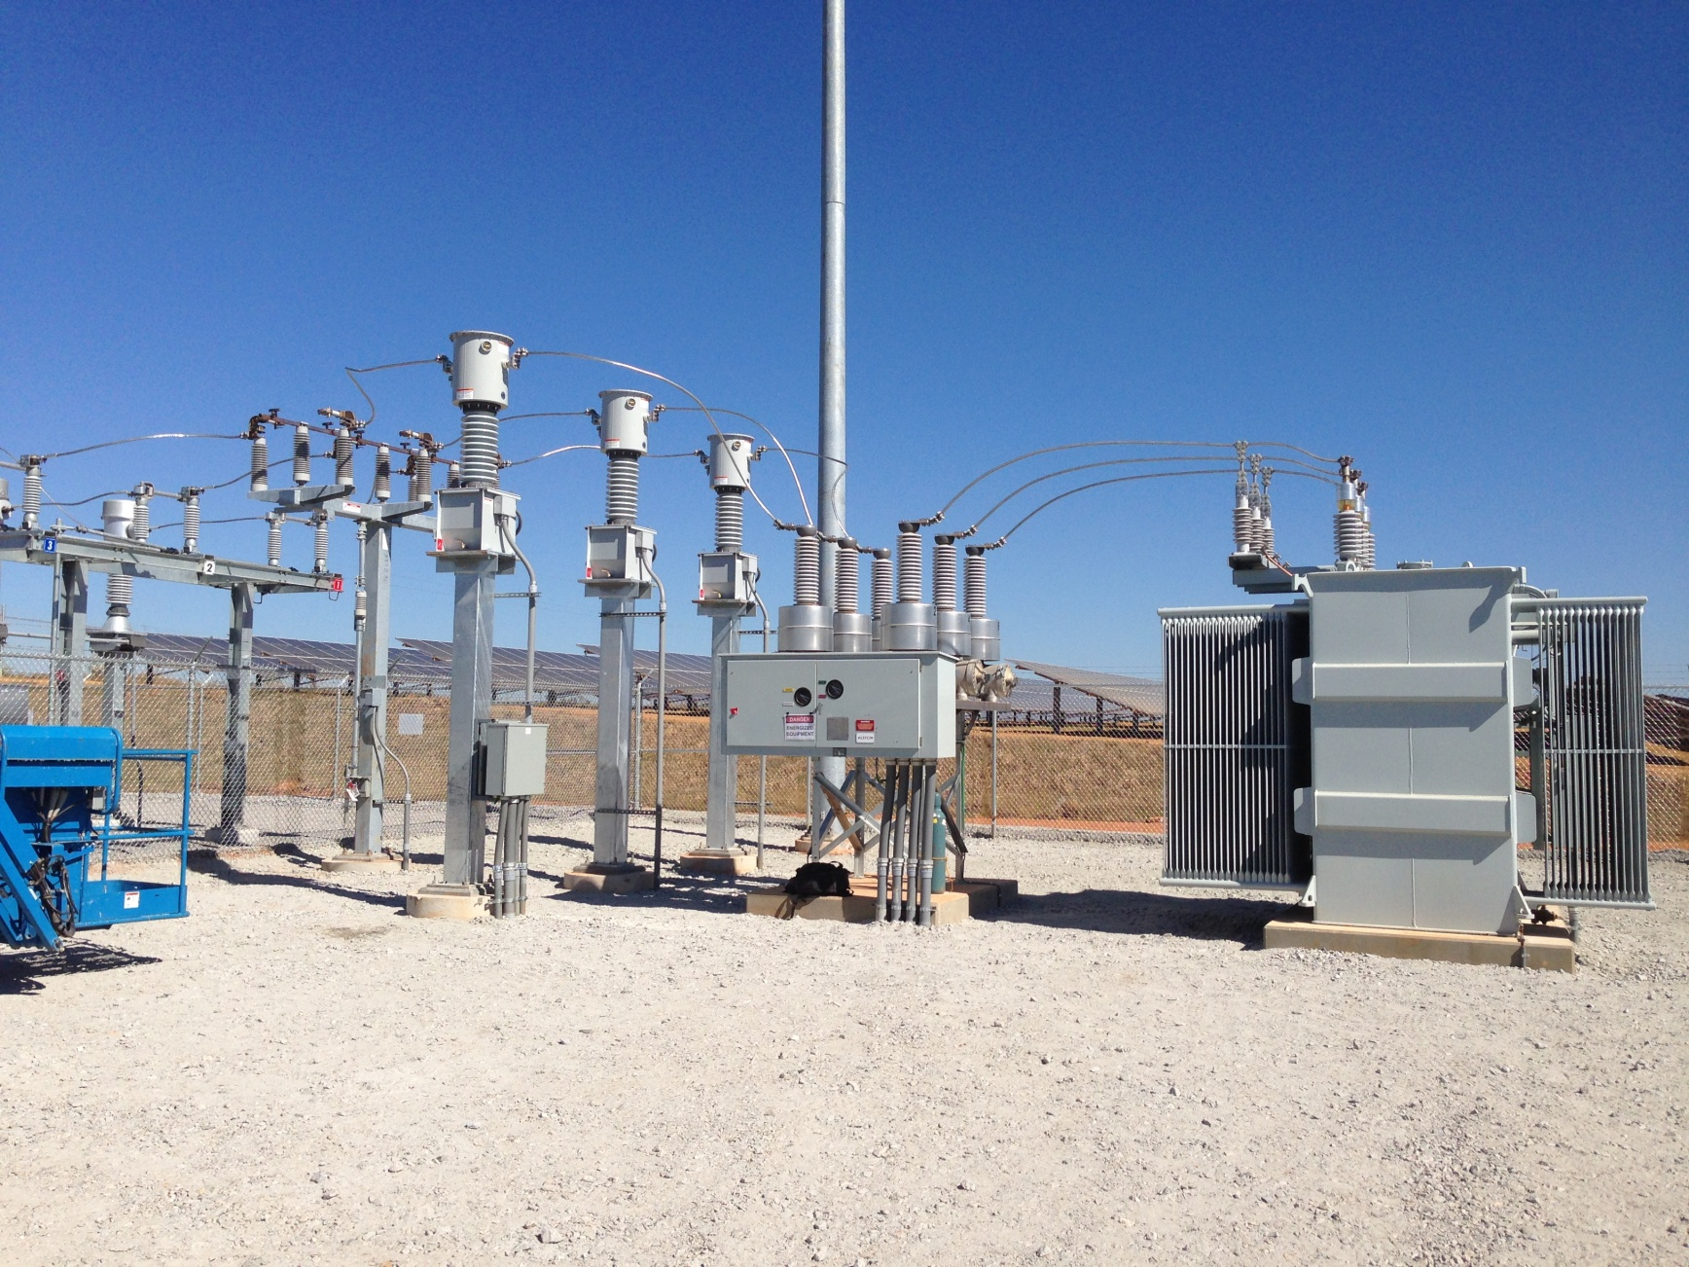
Interconnect

Slide 15
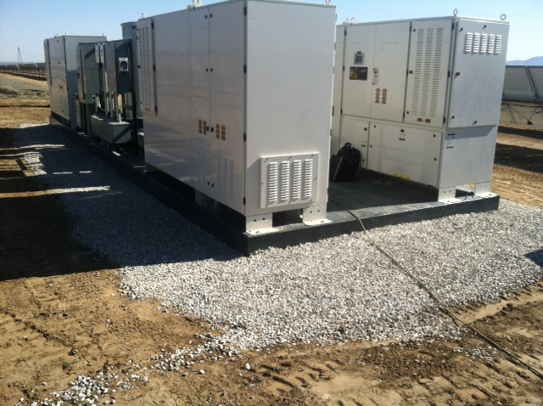
Foothills 34 MW
177,840 polycrystalline 295 W PV modules
20 modules per string; 8,892 strings
56 inverters; 20 - 1 MW & 36 - 0.5 MW
19 PCS skids with 2 MW of inverters & a 2.2 MVA transformer
12.47 kV Collector
7.5 MVAR Capacitors
69 kV Interconnect

Slide 16

Victor Phelan 17.5 MW
-78,624 modules
-3,744 strings
-35 - 500 kW inverters
-10 PCS skids
-34.5 kV Collector
-34.5 kV Interconnect

Slide 17
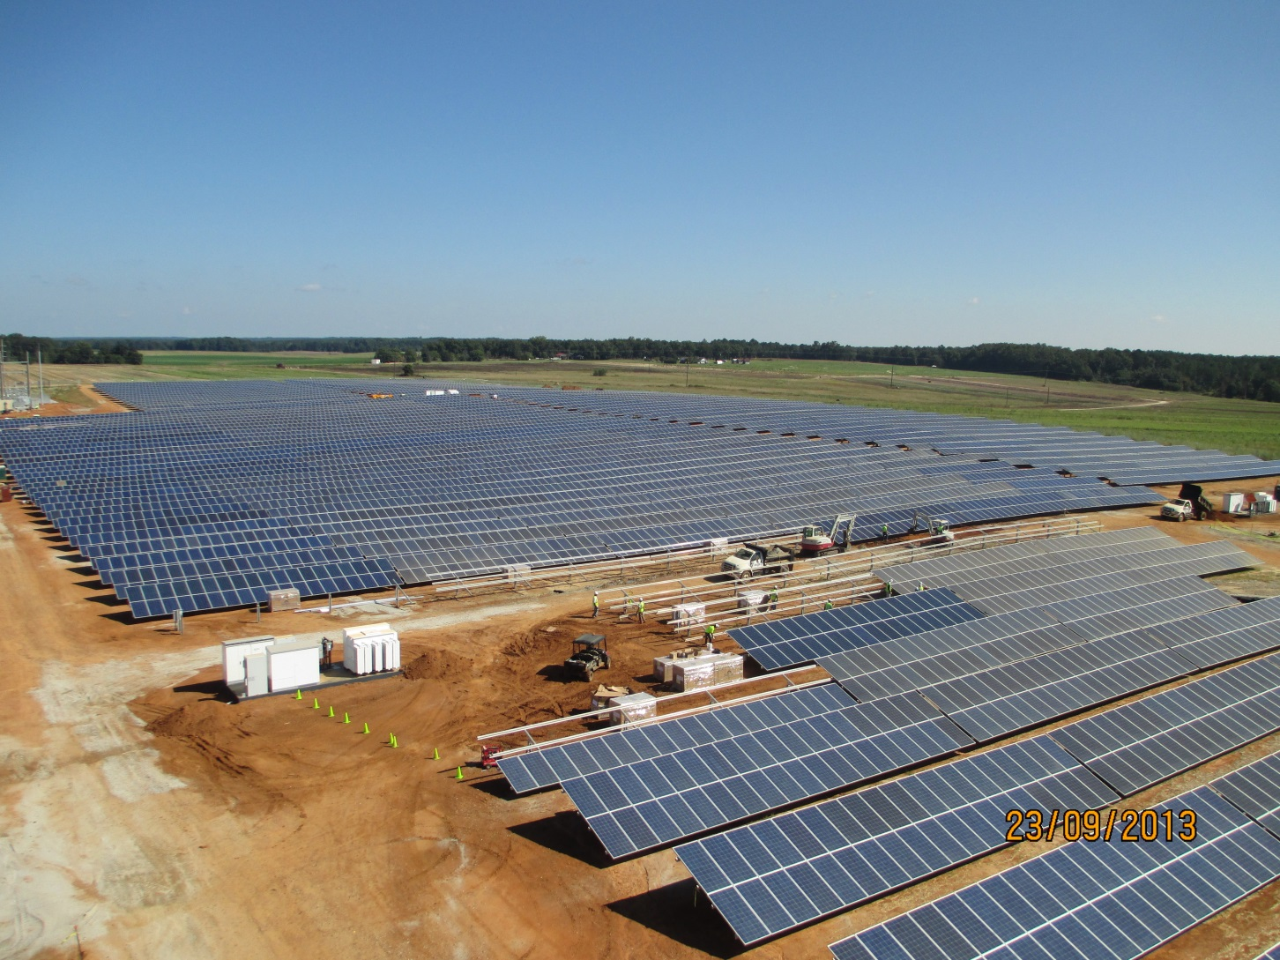
Azalea 7.5 MW Davisboro, Ga
-31,000 modules
-9 PCS skids
-9 months start to finish
-13.8 kV collector system
-46 kV interconnect

Slide 18
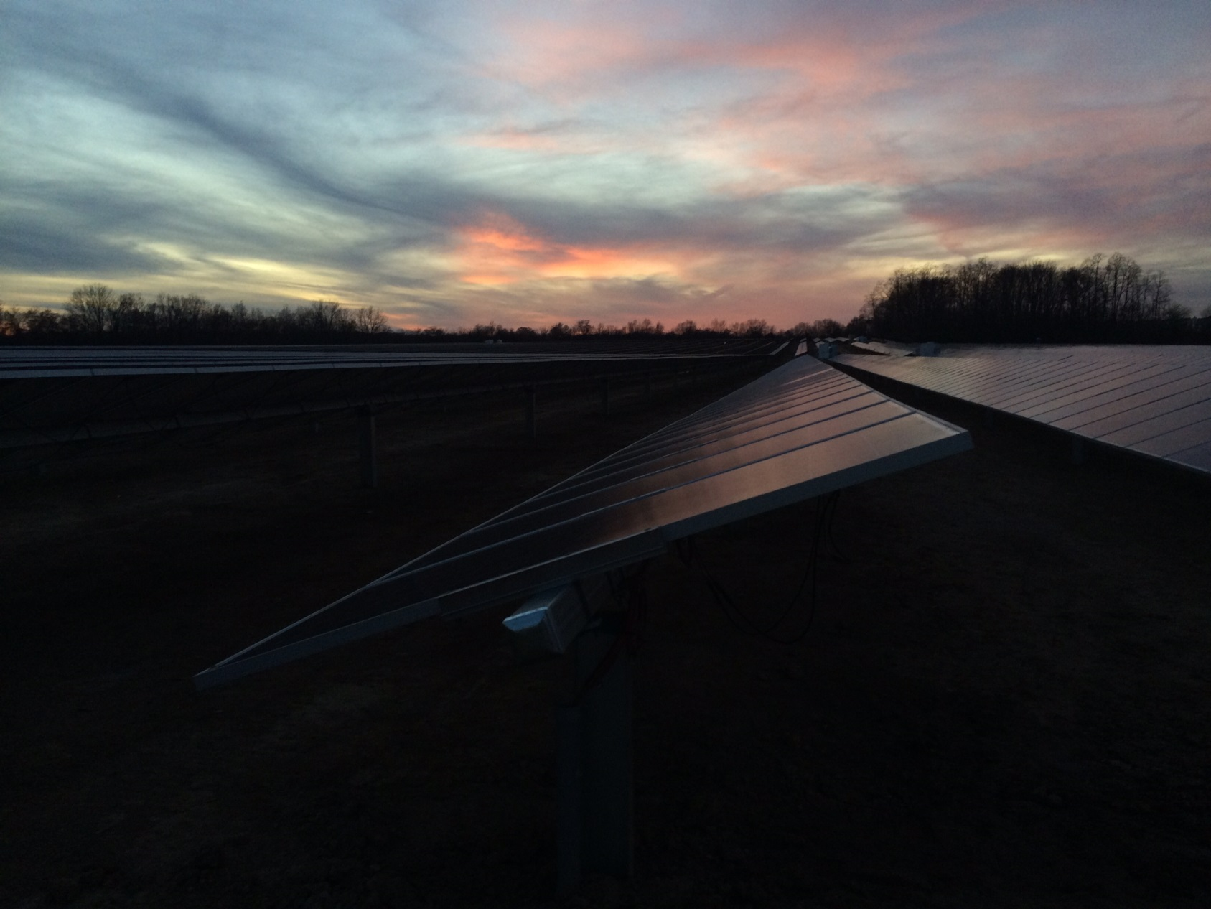
Indy Solar I,II,III
Started all 3 projects June 15 2013; completed December 15 2013.
Indy I & II were each 10 MW; had 46,284 modules; 2,436 strings; 14 inverters & 7 PCS’s
Indy III was 8.64 MW; had 39,672 modules; 2,088 modules, 12 inverters & 5 PCS’s

Slide 19
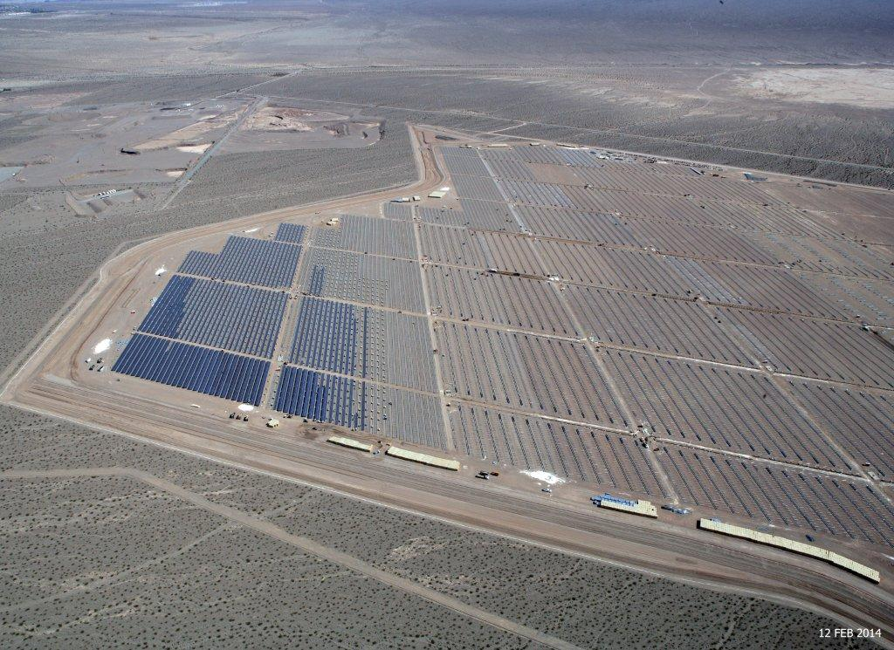
Copper Mountain Solar 3 250 MW
-1,132,800 modules
-56,640 strings
-255 - 1 MW inverters
-34.5 kV collector system
-525 kV interconnection
-Currently under construction

Slide 20
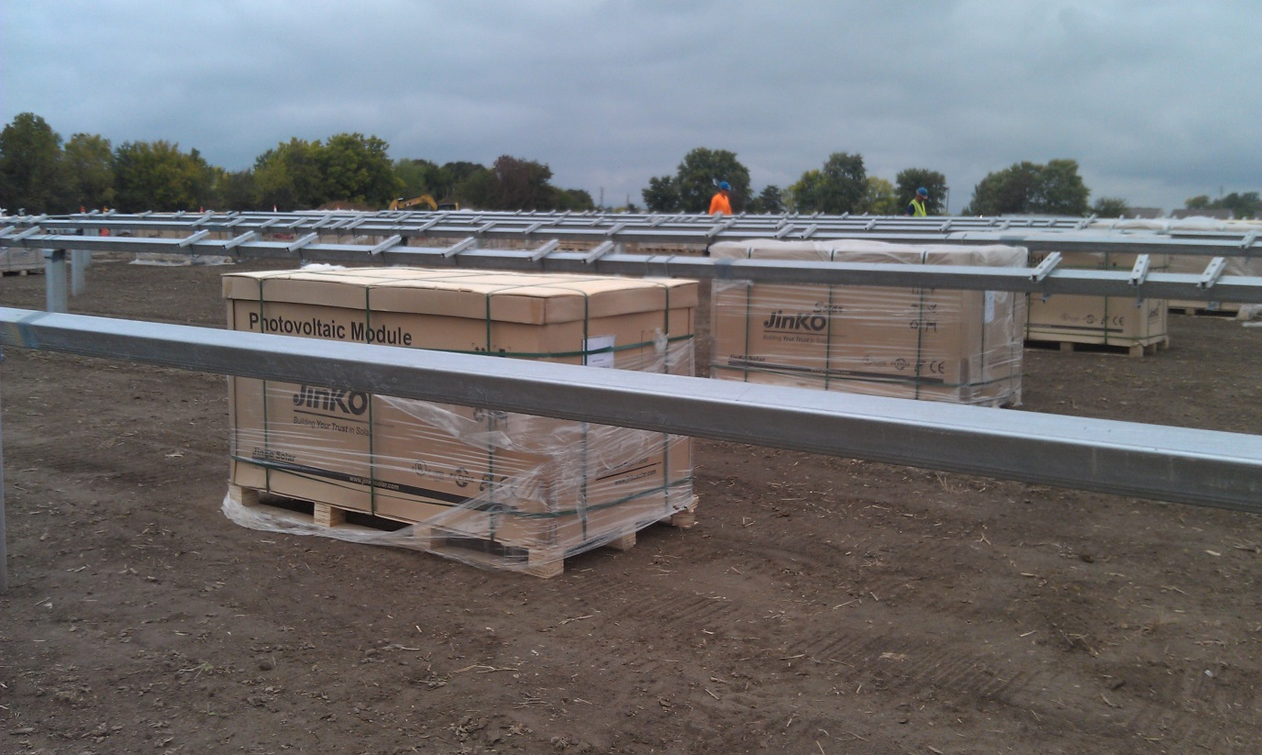

Some Assembly Required

Slide 21
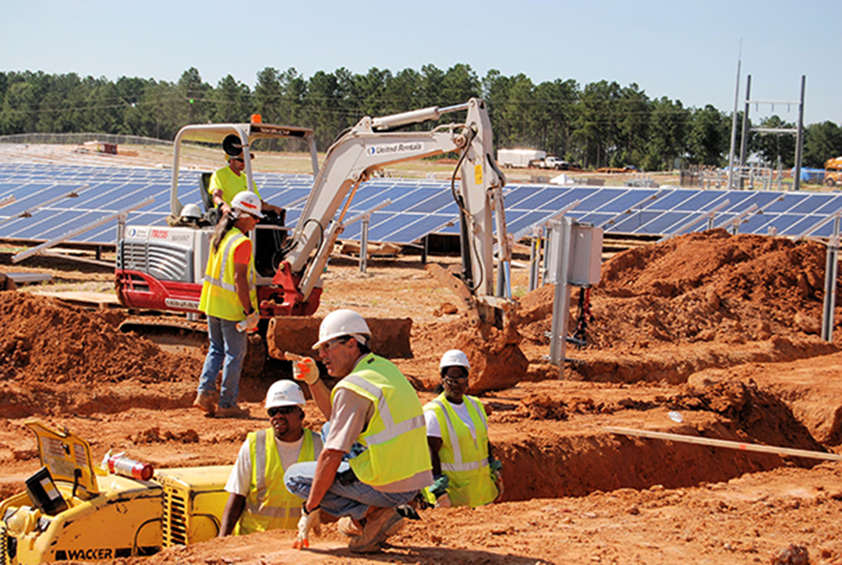
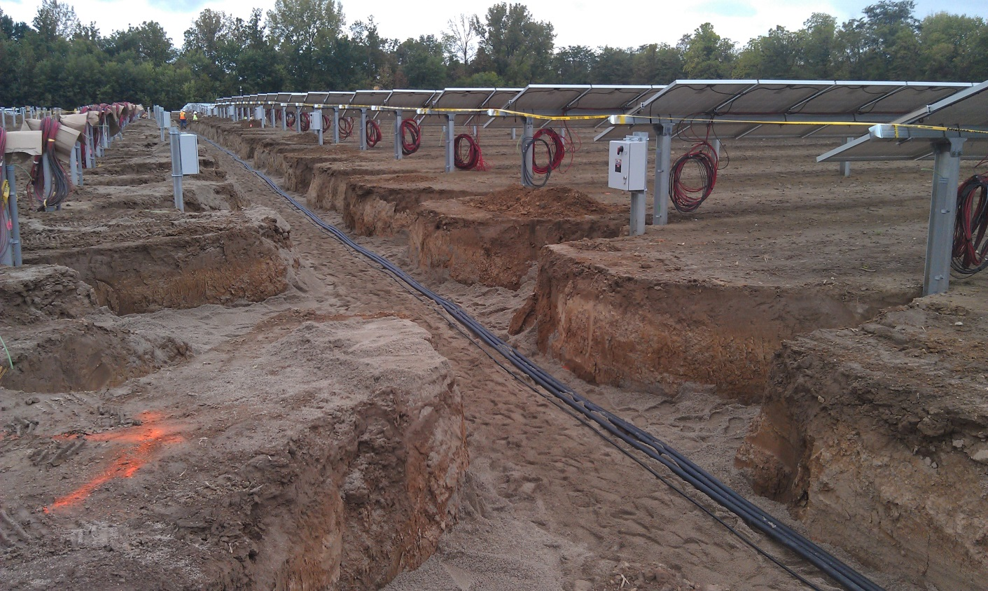
Lots of Trenches

Slide 22
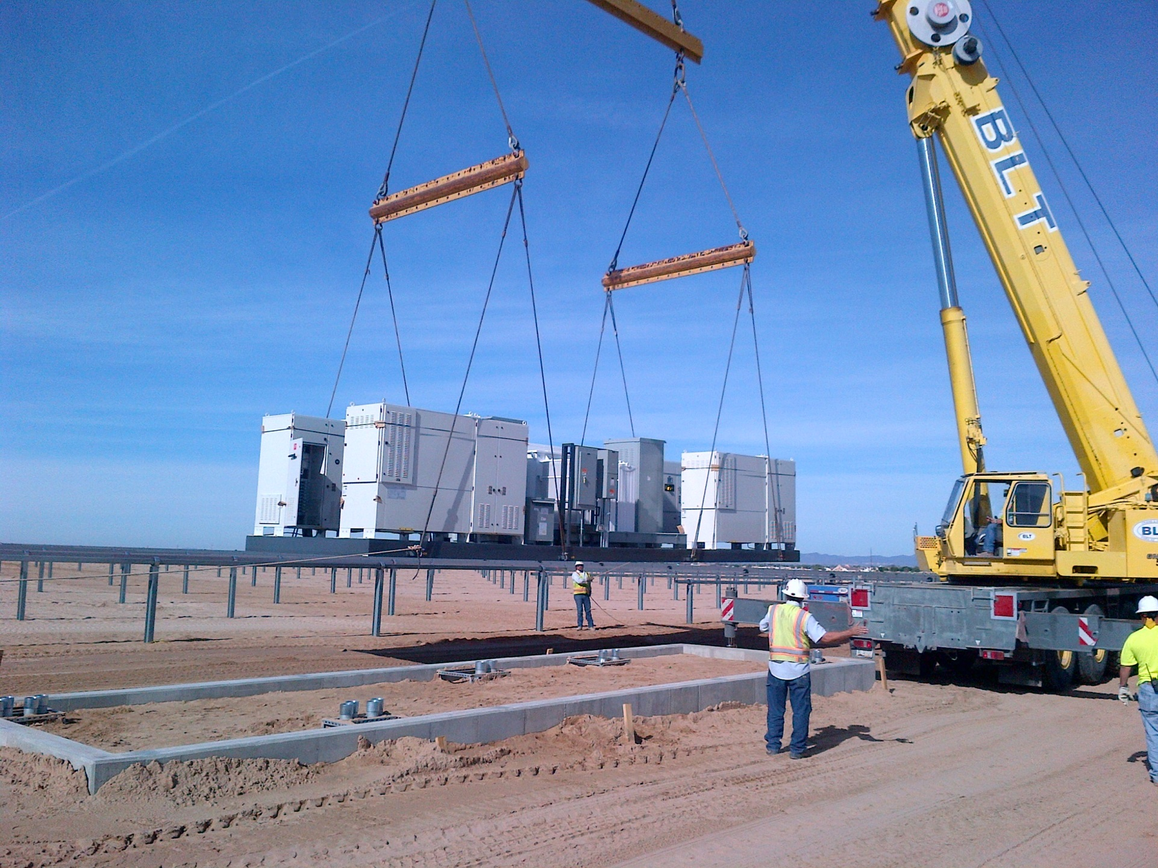
Installing the PCS

Slide 23
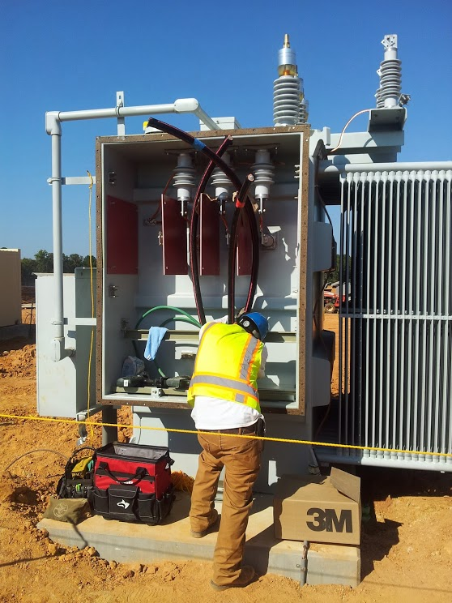
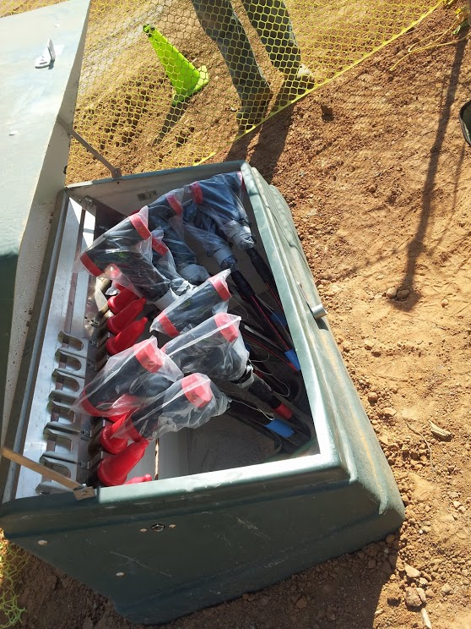
Lots of wiring

Slide 24
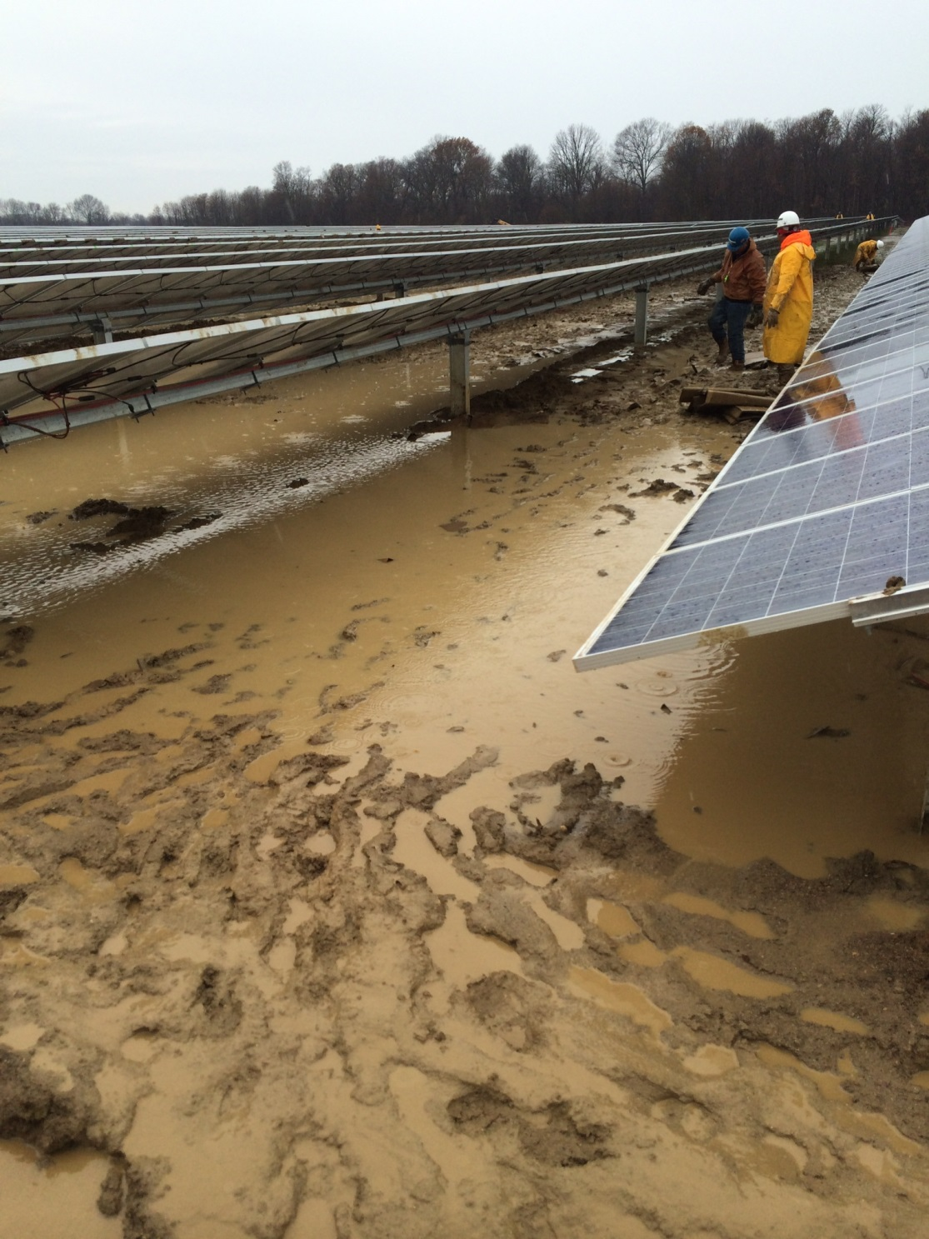
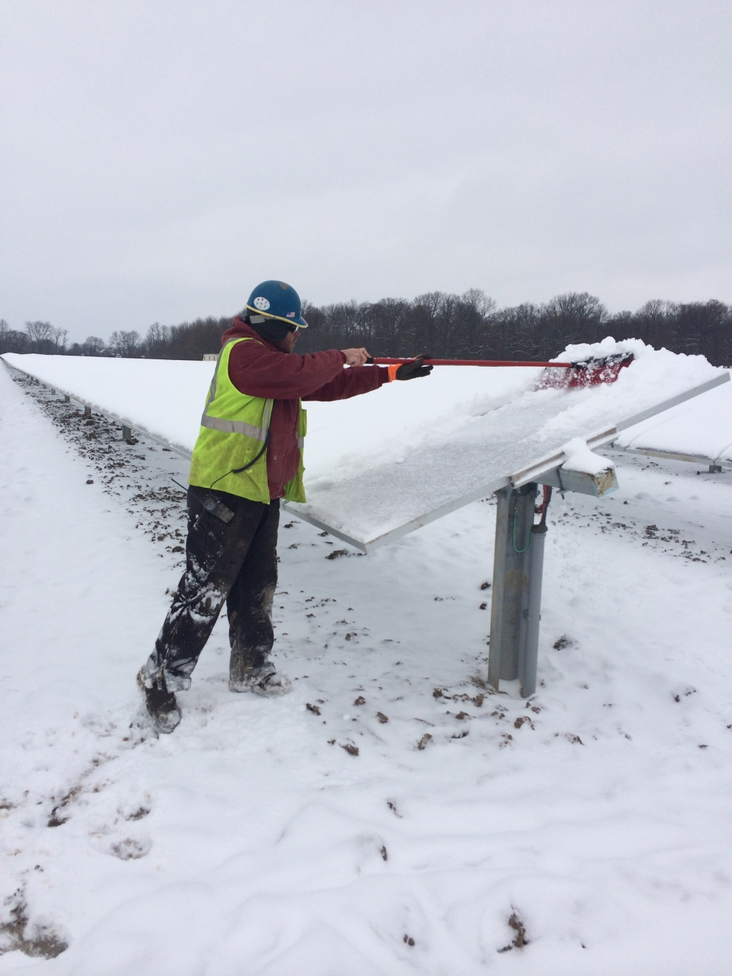
Neither snow nor rain…..

Slide 25
North American Grid Codes
Nice thought but we’re not there yet.

Slide 26
Interconnection Rules
ISOs RTOs
Balancing Authorities
State Energy Commissions

Slide 27
Point of Common Contention
IEEE 1547 says the DR (10 MVA or less) shall not actively regulate the voltage at the PCC & shall not cause the Area EPS service voltage at other local EPS’s to go outside C84.1 Range A.
C84.1 Range service voltage maximum 105% nominal; minimum 97.5% nominal

Slide 28
NERC Requirements
FERC Federal Energy Regulatory Commission has jurisdiction over interstate electricity sales & wholesale electric rates, appointed NERC North American Electric Reliability Corporation as the Electric Reliability Organization in US.
NERC’s mission is ensure the reliability of the bulk power system; their policies are now standards that are enforceable on bulk power system operators by financial penalties
FERC orders affect large & small generator interconnect agreements with a 4 step review process; scoping, feasibility, system impact and facility studies
FERC interconnect order 661-A for wind generators >20MW was the genesis of LVRT, reactive power & power factor requirements
NERC standards have implemented these orders for all generation on the bulk power system under their Voltage and Reactive (VAR) standard and 024-1 standard

Slide 29
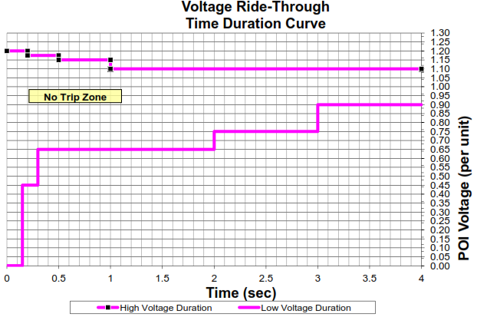
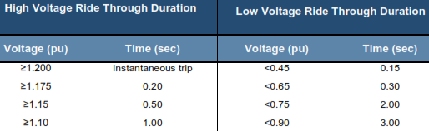
NERC 024-1 Voltage Ride Through

Slide 30
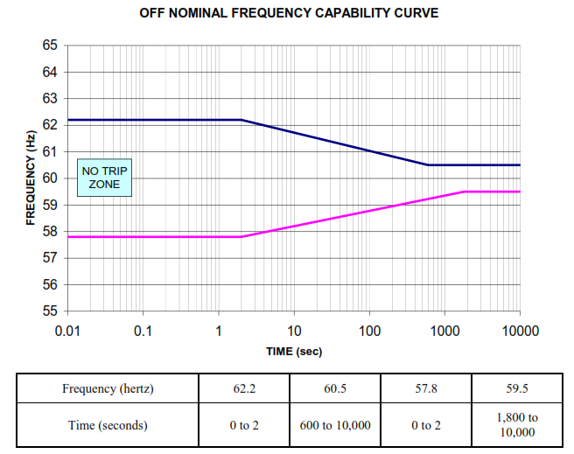
NERC 024-1 Frequency Limits

Slide 31
Conflict in application of standards
Primary consideration is protection
Overvoltage relay (59) settings very restrictive
Shall not actively regulate the voltage at the PCC & shall not cause the Area EPS service voltage at other local EPS’s to go outside C84.1 Range A.
C84.1 Range service voltage maximum 105% nominal; minimum 97.5% nominal
Primary consideration is reliability
Overvoltage relay (59) settings relaxed

Slide 32
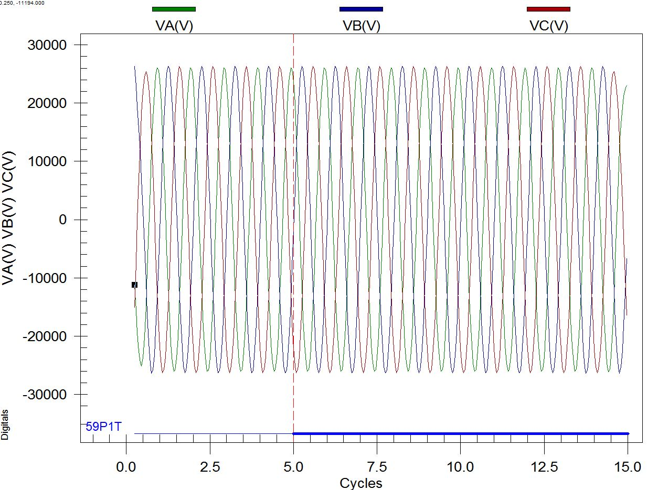
The Results
Persistent overvoltage trips where restrictive relay settings were employed or no voltage control (by VAR production or absorption) allowed. Precisely the problem that FERC & NERC wanted to resolve

Slide 33
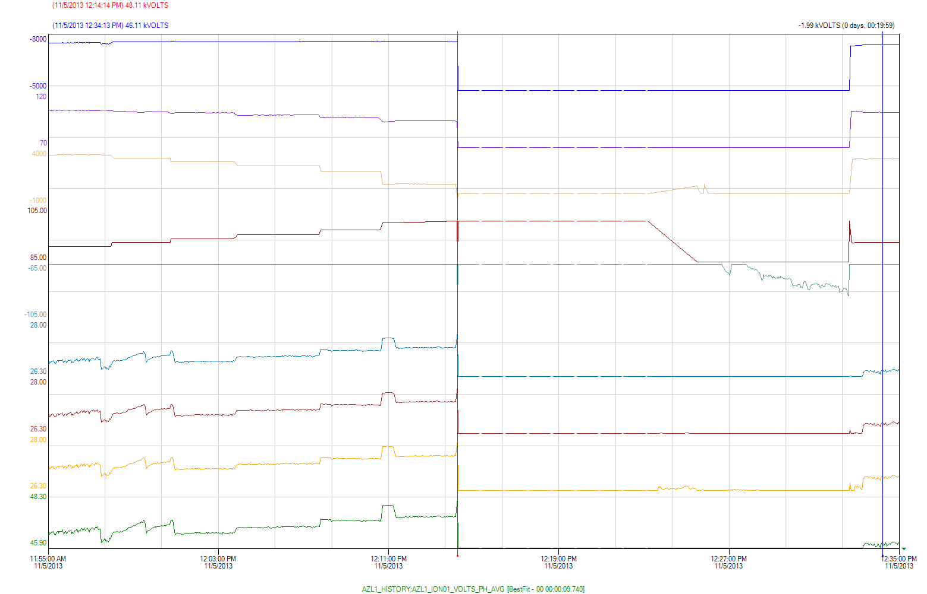
Success, Well Improvement

Slide 34
A variation on the same theme…unity PF operation & overvoltage trips at POI or inverter

Slide 35
Successful resolution by
allowing inverters to absorb
VARS the overvoltage issues
were resolved

Slide 36
FERC 661A Reactive Power Requirements
Provide reactive power to have a +/- 0.95 PF at POI (Point of Interconnect) or PCC
Synchronous machine considering
minimum power limits
Synchronous Generator reactive
capability curve
Typical PV Inverter reactive capability

Slide 37
PV Inverter Reactive Limitations
VARS are not imaginary. So where are they
going to coming from and what kind do
they need to be?
Could be
capacitors, static
Could be STATCOM,
dynamic

Slide 38
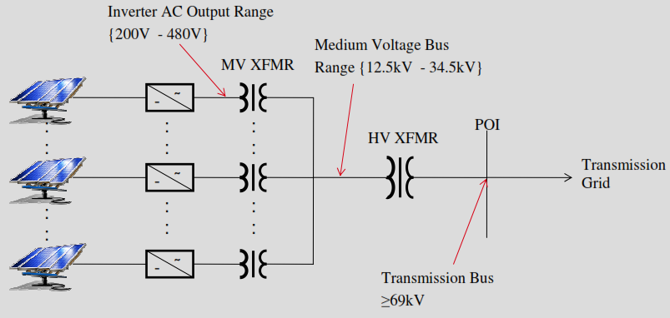
Project Reactive Power Example
40 MVA HV XFMR
37.2 MW OUTPUT
12.23 MVAR FOR 0.95 PF @ POI
69 KV HV
INVERTERS REACTIVE OUTPUT 12.58 MVAR
COLLECTOR SYSTEM LOSSES -2 MVAR
HV XFMR REACTIVE LOSSES -4 MVAR
CAP BANK REACTIVE OUTPUT (3@2) 6 MVAR
NET REACTIVE OUTPUT 12.58 MVAR

Slide 39
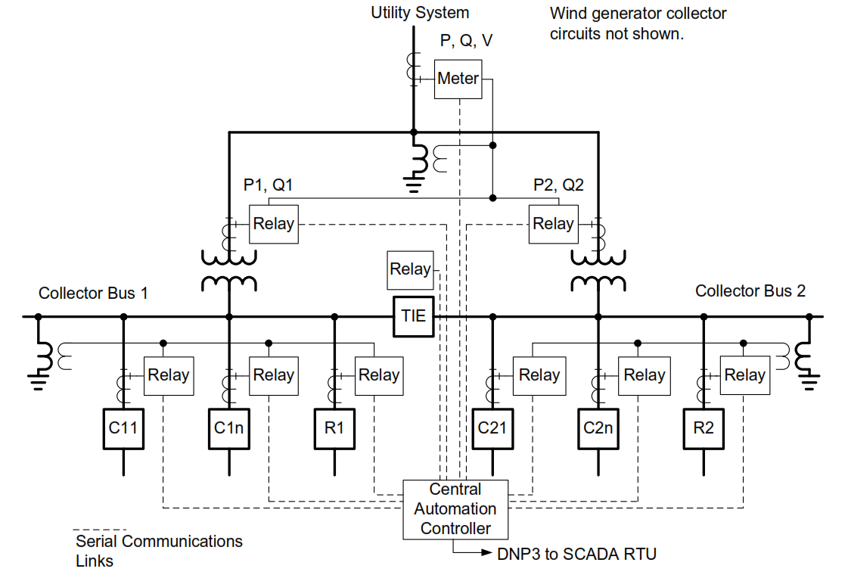
Collector System Reactive Power Control

Slide 40
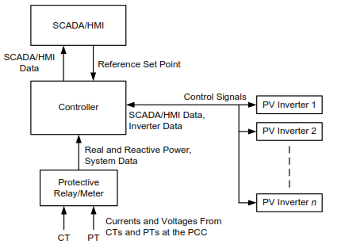
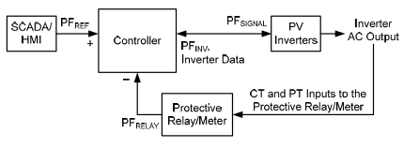
Closed Loop Reactive Power Control
Overall Schematic
PF Control

Slide 41
Volt / VAR Control
VARS circulate between buses of unequal voltage magnitude; when the system voltage
is low more VARS are needed to be generated, when the system voltage is high VARS
may need to be absorbed.

Slide 42
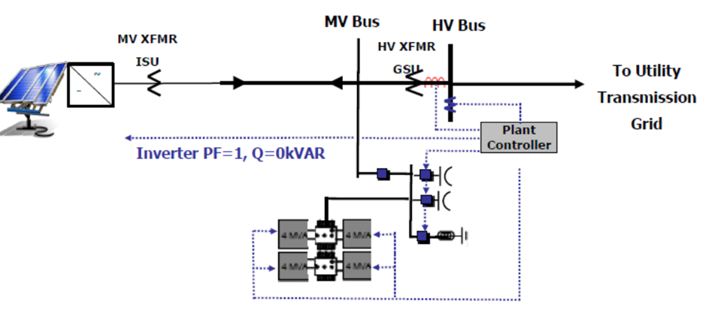
Can you get there from here?
Voltage and VARS are at the PCC (POI)
not in your plant. VARS flow from high
voltage (p.u.) to low voltage but you can
only go to 105%
Voltage Array (% VRef) |  | VAr Array (% VArAval)
V1 | 97 | Q1 | 50
V2 | 99 | Q2 | 0
V3 | 101 | Q3 | 0
V4 | 103 | Q4 | −50
Typical setpoints from Utility

Slide 43
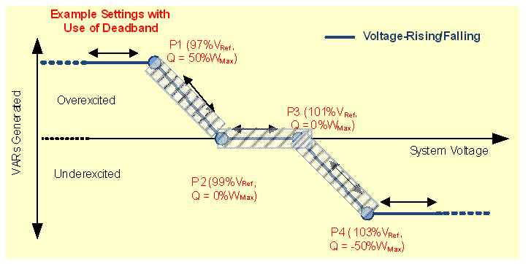
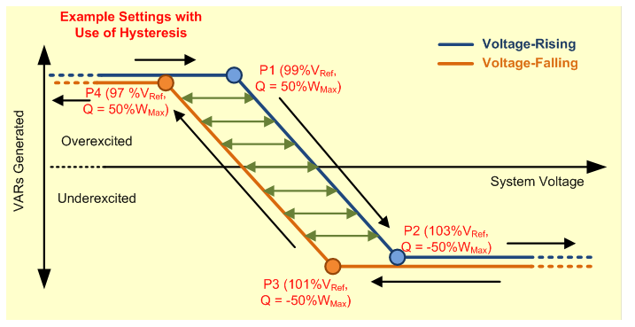
Dead band or Hysteresis for Stability
Typically +/-1 to 4 %
Time frame variable depending on
control system response time, anti-
islanding controls, static or dynamic
reactive power source utilization

Slide 44
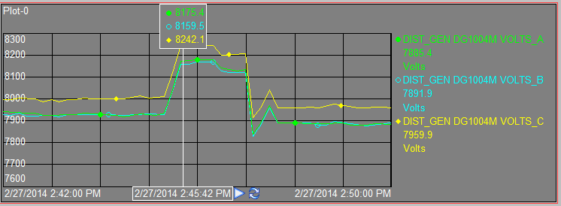

Example of Volt/VAR Control

Slide 45
11-11-13 Davisboro; Clear weather

Slide 46
11-09-13 Davisboro; Overcast weather

Slide 47

Ramp Rates
ERCOT, CAISO,PREPA & others have required a ramp rate maximum of 10% of nameplate
MW rating
Standard ramp rate
10% ramp rate
Establishing the use of ramp rates for moving from one
output level to another will help avoid sharp transitions
and the consequential power quality problems of
voltage spikes or dips, harmonics, and oscillations.
For large solar installations the ramp rate also prevents a system frequency deviation due
to a larger generation change.

Slide 48
1.2 MW PV On Island with 4.7 MW Load
Ramp rate limited 360 kw/min @ startup &
shutdown, 40-60 kw/sec operating
In this event a 35 kw/sec ramp produced a
0.12 hz frequency increase
With increased PV penetration levels ramp rates are becoming an issue.

Slide 49

Collector Circuit Relaying

Slide 50

That Can’t Be Right, Can It?

Slide 51

Interesting
Weather Trivia

Slide 52


